Slide 1
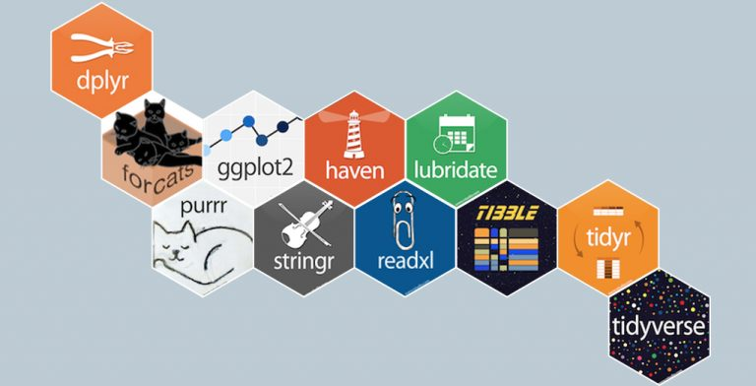
Tidyverse
A powerful collection of R packages for preparing, wrangling and visualizing data
一组处理与可视化R包的集合
install.packages("tidyverse")
library(tidyverse)

Slide 2
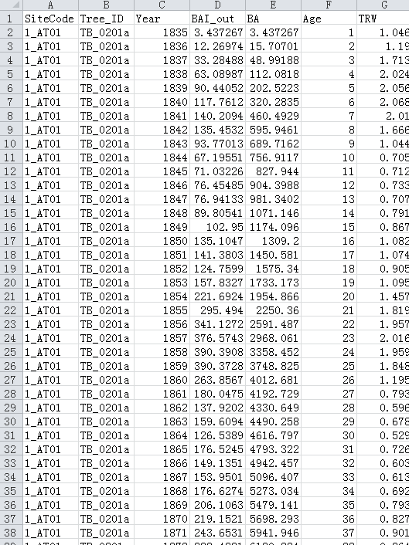
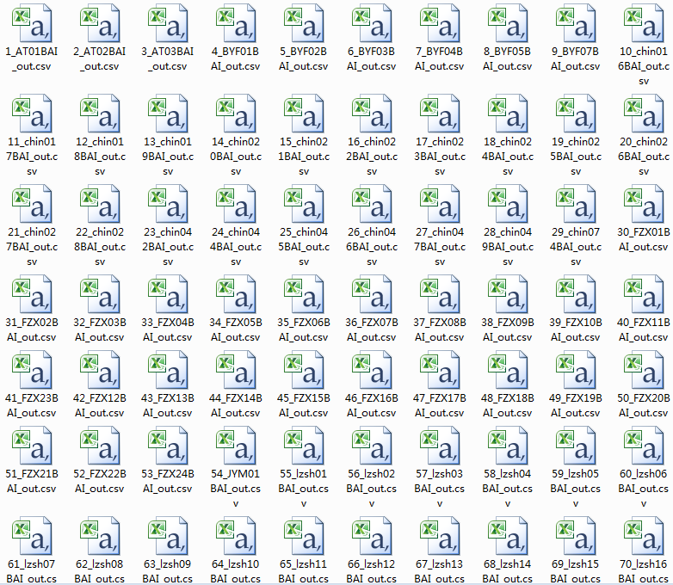
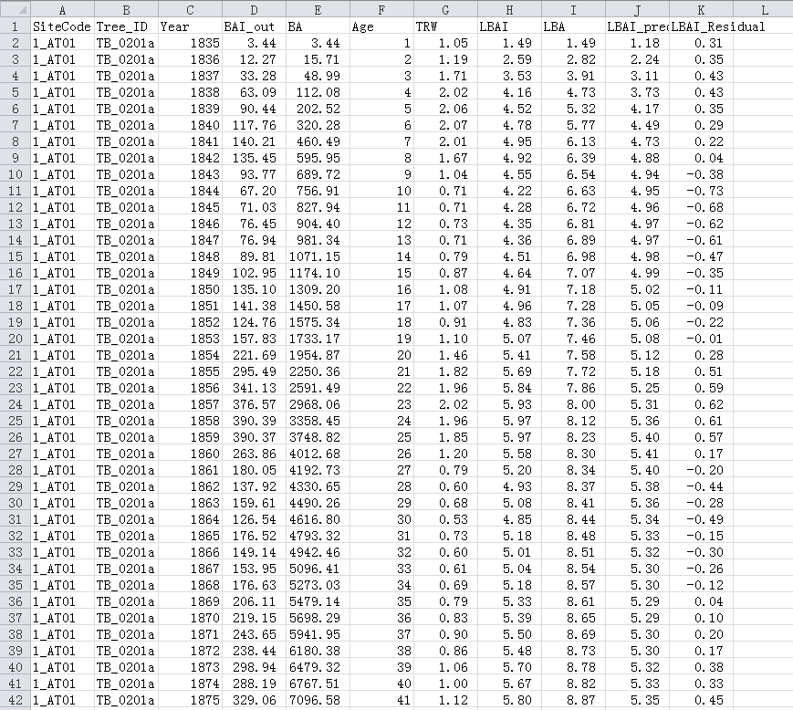
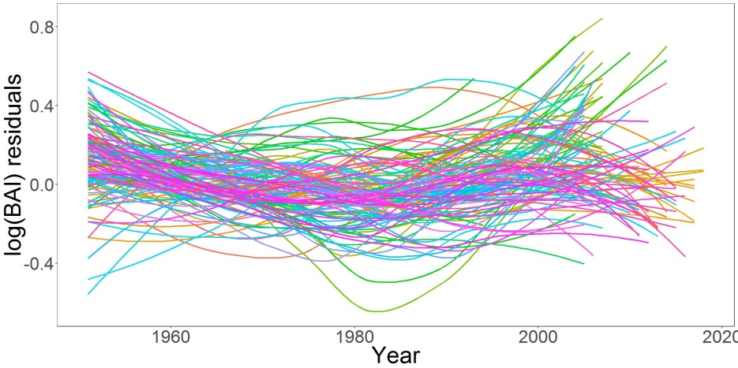

Slide 3
Data Import and Management
  tibble
  Readr
  Data Wrangling and Transformation
  dplyr
  tidyr
  stringr
  forcats
Functional Programming
  purrr
Data Visualization and Exploration
  ggplot2

Slide 4
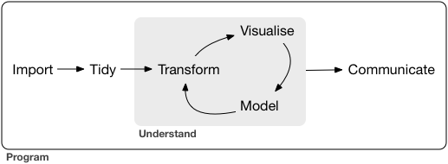
Dplyr
Forcats
Hms
Stringr
lubridate
ggplot2
Readr
Readxl
Xml2
DBI
Tibble
tidyr
Purr
magrittr

Slide 5


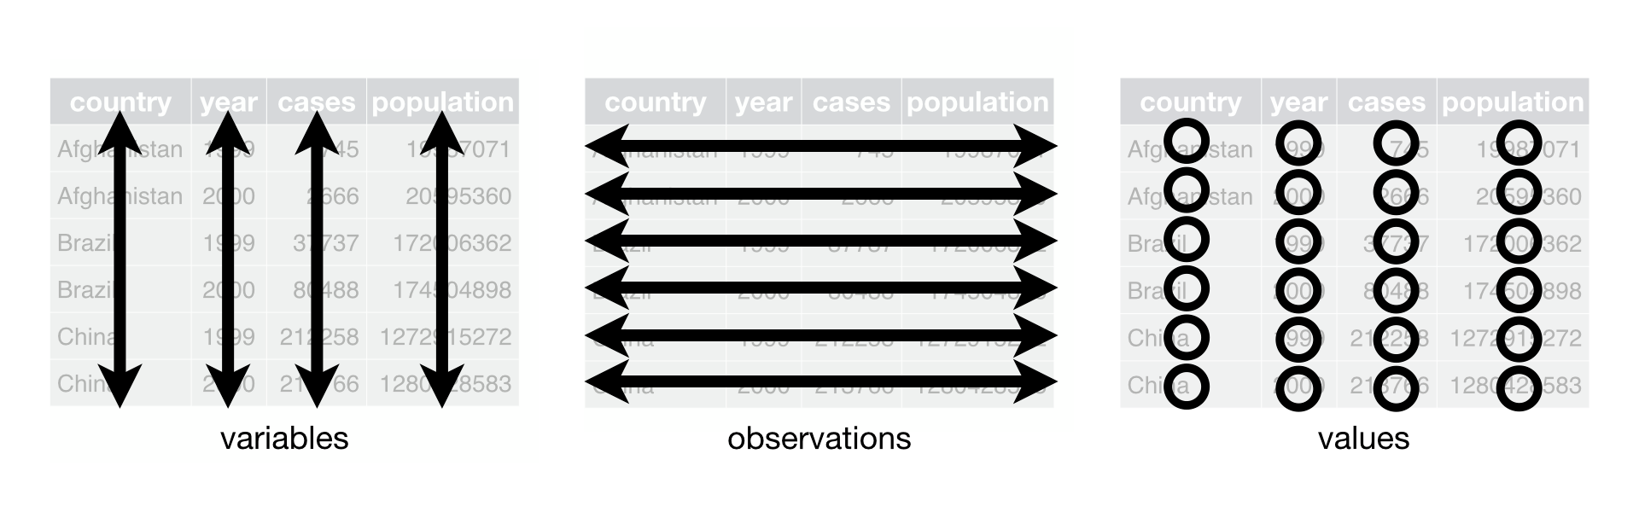
readr
数据录入
The readr package solves the problem of parsing a flat file into a tibble. This provides an improvement over the standard file importing methods and significantly improves the computation speed.
Every column is variable.
Every row is an observation.
Every cell is a single value.

Slide 6
%>%
管道函数
X %> f(y) means that x is ‘piped’ in to the function f(x, y)
Iris %>% head (n=2)
Iris %>% class()
Class(Iris)

Slide 7

tidyr
数据清理
gather(): The function “gathers” multiple columns from your dataset and converts them into key-value pairs
gather函数类似于Excel中的数据透视的功能，能把一个变量名含有变量的二维表转换成一个规范的二维表
spread(): This takes two columns and “spreads” them into multiple columns
spread用来扩展表，把某一列的值（键值对）分开拆成多列。
spread(data, key, value, fill = NA, convert = FALSE, drop =TRUE, sep = NULL)
separate(): As the name suggests, this function helps in separating or splitting a single column into numerous columns
将一列分离为多列
unite(): Works completely opposite to the separate() function. It helps in combining two or more columns into one
多列合并为1列

Slide 8
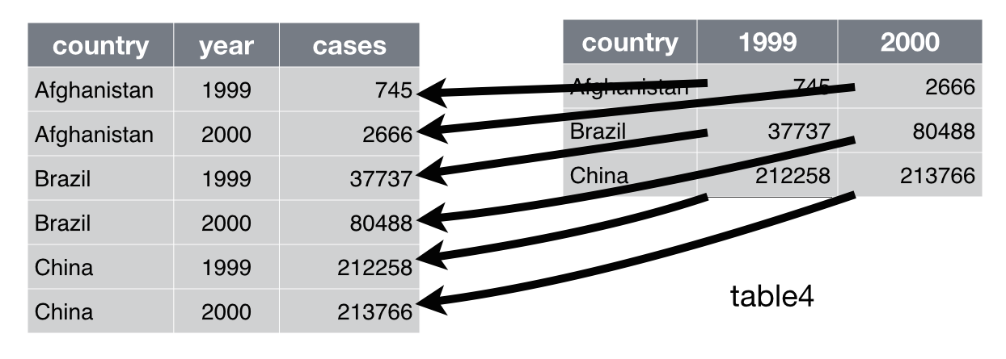
tidyr | gather | spread
reshape(2) | melt | cast
spreadsheets | unpivot | pivot
databases | fold | unfold
gather(data, key, value, …, na.rm = FALSE, convert = FALSE)
data：需要被转换的宽形表
key：将原数据框中的所有列赋给一个新变量key
value：将原数据框中的所有值赋给一个新变量value …：
可以指定哪些列聚到同一列中
na.rm：是否删除缺失值
Gather(data, key=“year”, value=“cases”

Slide 9
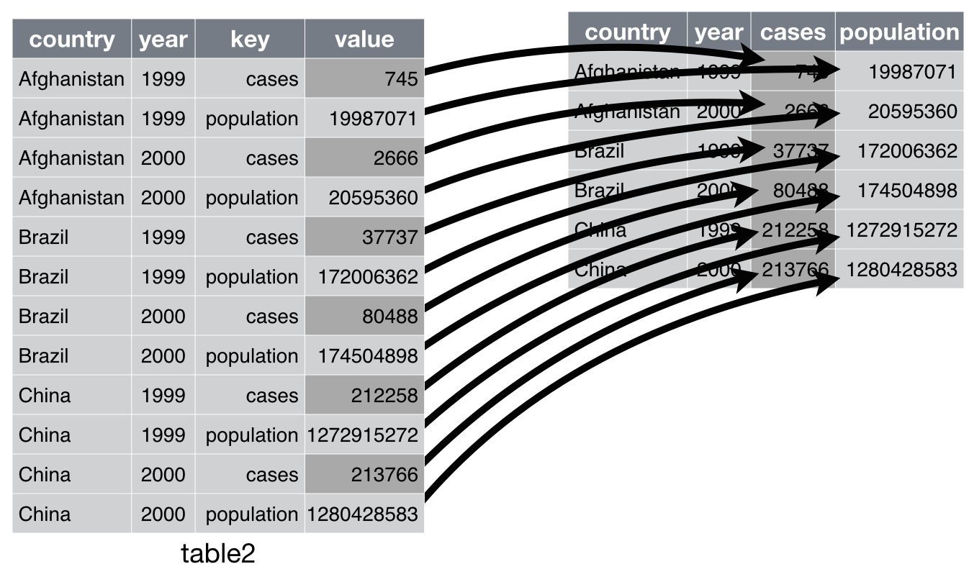
spread(data, key, value, fill = NA, convert = FALSE, drop = TRUE)
data：为需要转换的长形表
key：需要将变量值拓展为字段的变量
value：需要分散的值
fill：对于缺失值，可将fill的值赋值给被转型后的缺失值
Spread(data, key=“key”, value=“value”

Slide 10
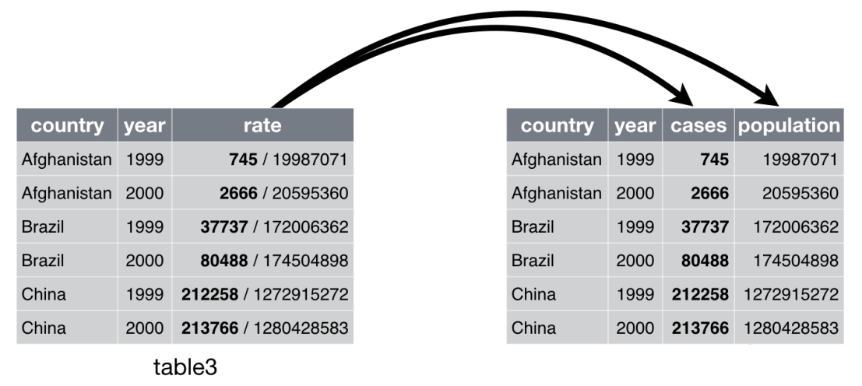
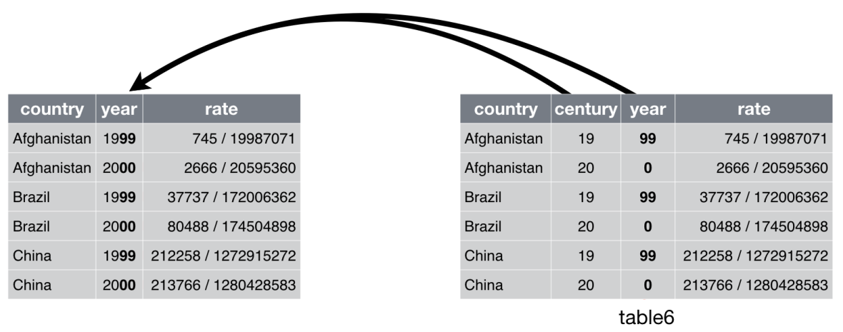
separate()函数可将一列拆分为多列，一般可用于日志数据或日期时间型数据的拆分
separate(data, col, into, sep = “[^[:alnum:]]+”, remove = TRUE, convert = FALSE, extra = “warn”, fill = “warn”, …)
data：为数据框 col：需要被拆分的列
into：新建的列名，为字符串向量
sep：被拆分列的分隔符
remove：是否删除被分割的列
separate(rate, into = c("cases", "population"))
unite(data, col, …, sep = “_”, remove = TRUE)
data：为数据框
col：被组合的新列名称 …：指定哪些列需要被组合
sep：组合列之间的连接符，默认为下划线
remove：是否删除被组合的列
unite(new, century, year)

Slide 11


Data Wrangling and Transformation
dplyr
数据操控和转换
select(): Select columns from your dataset. 选择
filter(): Filter out certain rows that meet your criteria(s). 筛选
group_by(): Group different observations together such that the original dataset does not change. Only the way it is represented is changed in the form of a list. 分组
summarise(): Summarise any of the above functions. 汇总
arrange(): Arrange your column data in ascending or descending order. 排序
join(): Perform left, right, full, and inner joins in R
mutate(): Create new columns by preserving the existing variables. 变形
group_by通常与summarise搭配使用

Slide 12
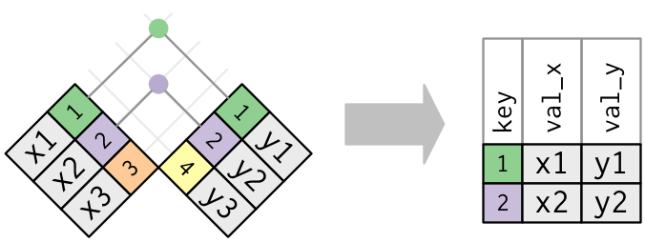
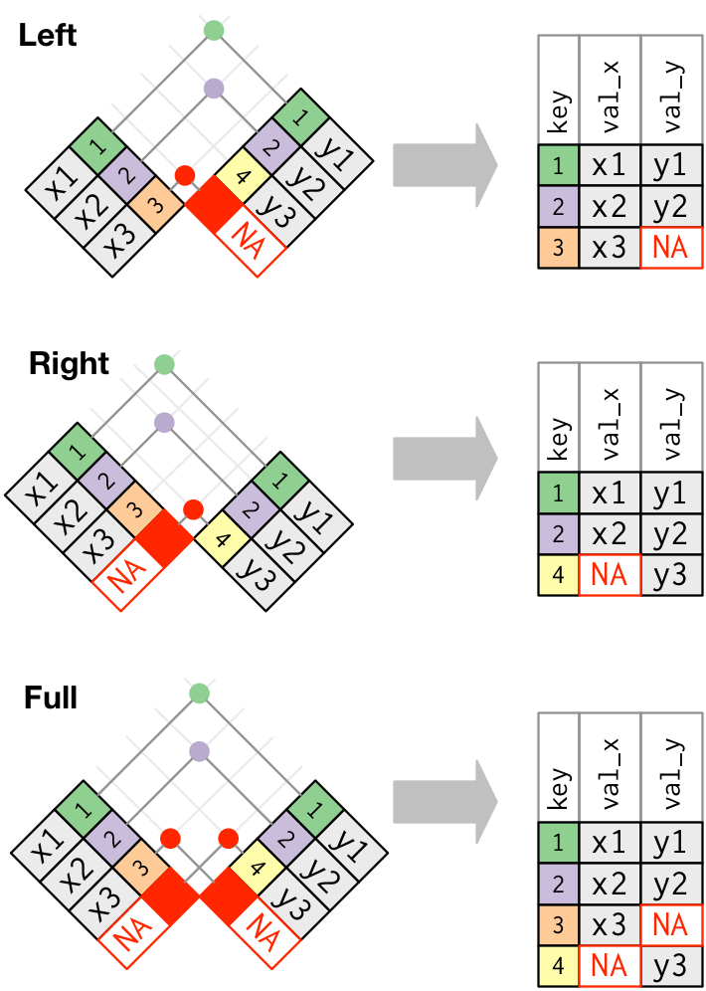
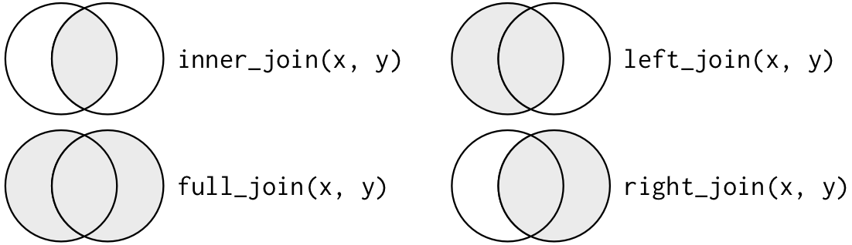
dplyr | merge
inner_join(x, y) | merge(x, y)
left_join(x, y) | merge(x, y, all.x = TRUE)
right_join(x, y) | merge(x, y, all.y = TRUE),
full_join(x, y) | merge(x, y, all.x = TRUE, all.y = TRUE)
Join(): join two tbls together
inner_join()
  An inner join matches pairs of observations whenever their keys are equal
left_join()
A left join keeps all observations in x.
right_join()
  A right join keeps all observations in y.
full_join()
  A full join keeps all observations in x and y.

Slide 13
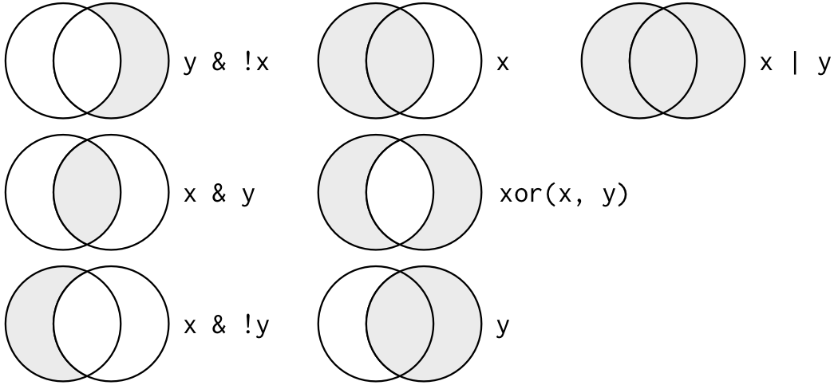
filter
Logical operators:
& is “and”, | is “or”, and ! is “not”

Slide 14

Functional Programming
purrr
函数编辑
The purrr package in R provides a complete toolkit for enhancing R’s functional programming.
The following example uses purrr to solve a fairly realistic problem: split a data frame into pieces, fit a model to each piece, compute the summary, then extract the R².
mtcars %>% split(.$cyl) %>% # from base R map(~ lm(mpg ~ wt, data = .)) %>% map(summary) %>% map_dbl("r.squared")
map() makes a list.
map_lgl() makes a logical vector.
map_int() makes an integer vector.
map_dbl() makes a double vector.
map_chr() makes a character vector.

Slide 15
forcats
处理因子和分类变量
The forcats package is dedicated to dealing with categorical variables or factors. Anyone who has worked with categorical data knows what a nightmare they can be. forcats feels like a godsend.

Slide 16

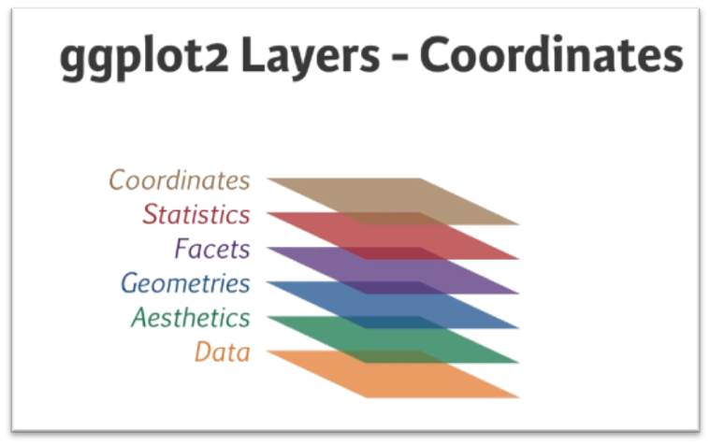
Data Visualization and Exploration
ggplot2
数据可视化和作图
Data scientists universally love using ggplot2 to produce their charts and visualizations.
library(ggplot2)
ggplot(Data, aes(x = drug_treatment, y = mmse, fill=drug_treatment)) +
geom_boxplot(color = "black", width = 0.7) +
facet_grid(sex~health_status) +
scale_fill_manual(values = c("green", "blue", "red"))+
theme_bw() +
theme(axis.title = element_text(size = 20),
axis.text = element_text(size = 12))

Slide 17
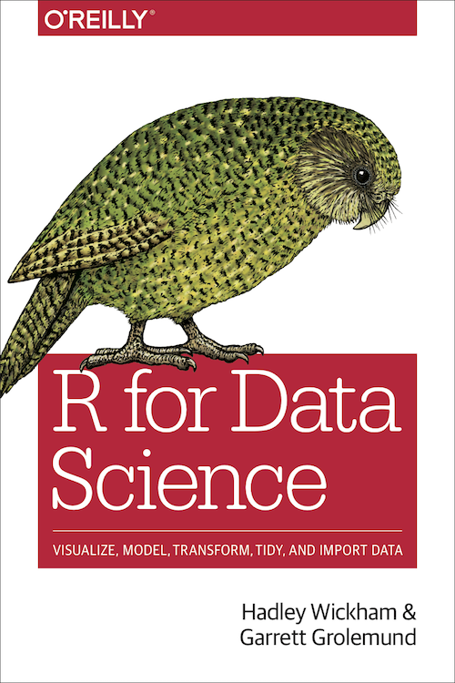
References:
https://r4ds.had.co.nz/

